Slide 1
Multithreading & Multiprocessing
correlationzero

Slide 2
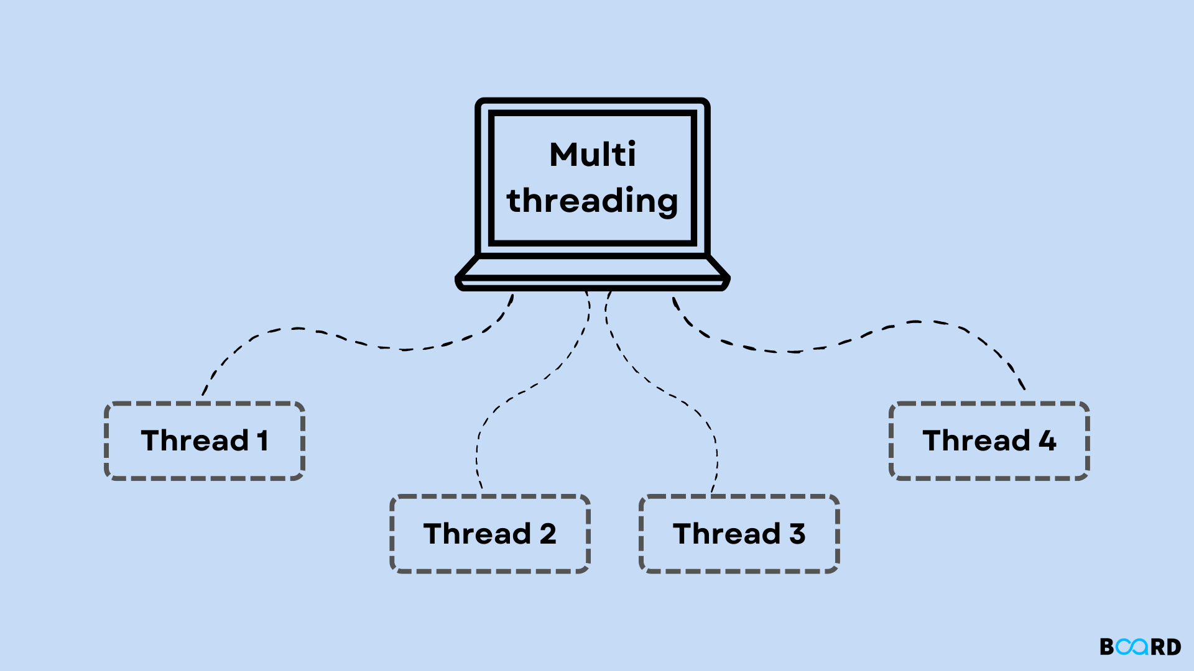
What is Multithreading
It is a programming technique that assigns multiple threads to a single process to run concurrently to each other.
These threads share the same memory space within a parent process

Slide 3
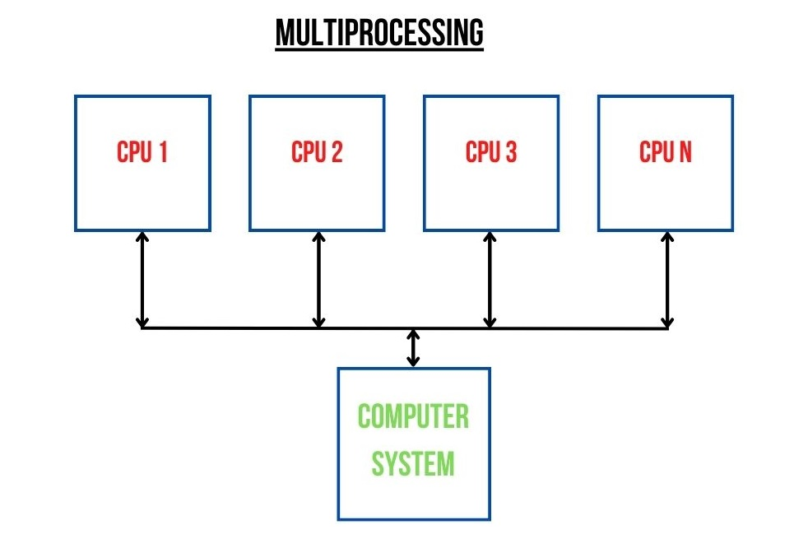
What is Multiprocessing
It refers to a system that has more than two central processing units (CPUs). Every additional CPU added to a system increases its speed, power and memory.
This allows users to run multiple processes simultaneously.
Each CPU may also function independently, and some CPUs may remain idle if they don't have anything to process

Slide 4


Why we use it
Optimizing Time for Handling big data and performing complex computational tasks.

Slide 5
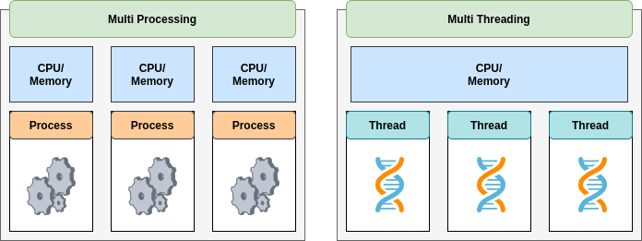
Multiprocessing VS Multithreading

Slide 6
Practical Implementation of Multiprocessing and Multithreading

Slide 7
References
Multithreading vs. Multiprocessing: What's the Difference?
Difference Between Multiprocessing and Multiprogramming
Multithreading and Multiprocessing
ChatGPT

Slide 8
THANK YOU

